Slide 1

Theory of production
Parjita Munshi
S.Y. IT-1
160410116064
ENGINEERING ECONOMICS AND MANAGMENT

Slide 2
WHAT IS PRODUCTION ?
Production is a basically an activity of transformation.
In economics , the term ‘production’ means a process by which resource are transformed into a different and more useful commodities or service .

Slide 3
In general production means transforming inputs into outputs…
This transformation is the following kinds:
• Change in the Form(Raw material transformed to finished goods )
•Change in Place( Supply chain, Factory to Retailer)

Slide 4
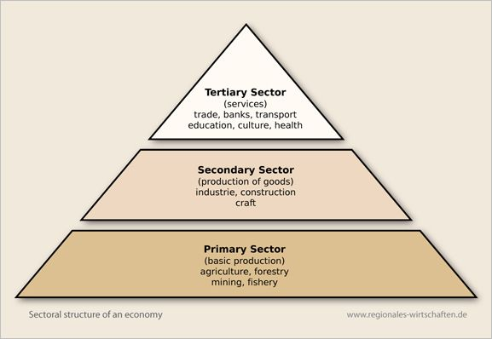
CLASSIFICATION BASED ON THE PROCESS OF PRODUCTION.

Slide 5
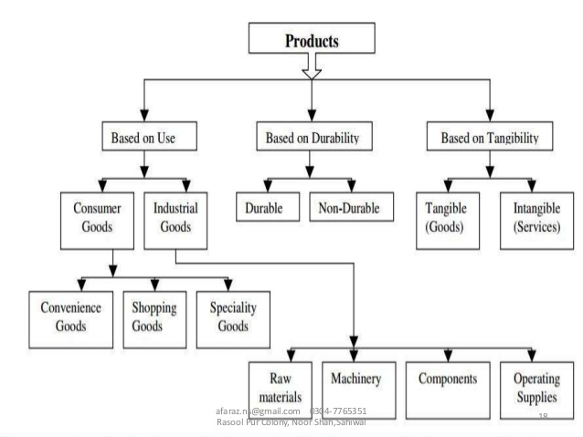

Slide 6
FACTOR OF PRODUCTION
Factors of production is an economic term that describes the inputs that are used in the production of goods or services in order to make an economic profit.
The main 4 factors of production are..
Land (including all natural resources),
Labor (including all human resources),
Capital (including all man-made resources), and.
Enterprise (which brings all the previous resources together for production).

Slide 7
Laws of production
Laws of variable proportion
Relates to the study of input output relationship in the short run with one variable input while other variable are remain constant.
Laws of return to scale
Relates to the study of input output relationship in the long run assuming all inputs to be variable.

Slide 8
Laws of returns to a variable factor(short run time period).
this law shows the Nature of rate of change in output due to the change in only one variable factors of production.

Slide 9
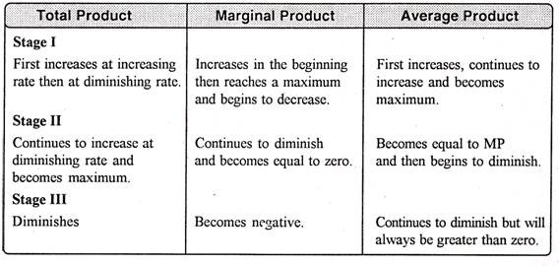
Three stage of law of variable proportion.

Slide 10
Law of return to scale (long run time period)
This law indicates the rate of change in output due to this increasing in all factors of production by at a given percentage in the same direction. This law is applicable during the long-run when the firm can change all the factors of production by any given percentage.

Slide 11
Three types of return to scale.
Constant return to scale: if the output changes in the same proportion to those of inputs, we say that we have constant return to scale.
Decreasing returns to scale: if all the inputs are changed in certain proportion, and the change in a similar proportion, we have decreasing returns to scale.
Increasing returns to scale: when all inputs ae changed in a certain proportion ,and changed in a output is in a lager proportion, we have increasing returns to scale.

Slide 12
PRODUCTION FUNCTION
In economics, a production function relates physical output of a production process to physical inputs or factors of production.
An empirical production function is generally so complex to include a wide range of inputs: land, labour, capital, raw materials, time, and technology.
• These variables form the independent variables in a firm’s actual production function.
• A firm’s long-run production function is of the form:
• Q = f(Ld, L, K, M, T, t)
where Ld = land and building; L = labour; K = capital; M = materials; T = technology; and, t = time.

Slide 13
CASE STUDY
Company : Vandana Textile Ltd.
No of employee:400
No of years in business:30
Buisness : textile(spinning and weaving of white linen)
Target : to expand in domestic and expert market.
When the company was started , they had 500 workers , the company used old technology to produce clothes . Labour as mainly used while machine was minimally used.
The plan was modernised and mechanized over the years production(15000m to 60,000m everyday(maximum technical efficiency)
What should the company be doing in order to increas3 sales and increase their impact in the international market.

Slide 14
Solution:
To produce bed sheet , pillow covers etc.
Mechanizing the plant further
Hire specialized labour
To improve market information.
retrench labour
Import machines

Slide 15
THANK YOU.

